Slide 1
CS-UY 4563 Final Project
Liheng Cao, Aaron Hsieh

Slide 2
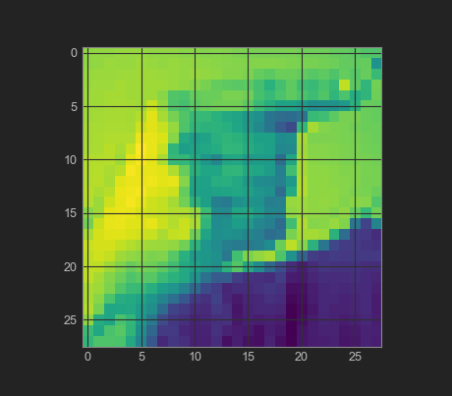
Problem/Dataset
Sign language
24 letters; j,z require motion
One-hot encoding
DL: 28x28, ML: 784x1
27,455 training examples
7172 testing examples

Slide 3
Models Used
Logistic Regression
SVM
Convolutional Neural Network

Slide 4
Scalers
MinMaxScaler()
X_min = X.min(axis=0)
X_max = X.max(axis=0)
X = (X-X_min) / (X_max-X_min)
StandardScaler()
X_mu = X.mean(axis=0)
X_std = X.std(axis=0)
X = (X-X_mu) / X_std

Slide 5
Logistic Regression
We varied:
Type of scaling
Amount of regularization
L1 Regularization did not finish in a reasonable amount of time, so it was excluded.

Slide 6
Logistic Regression; L2
Best result
Standard scaler
C=0.01
70.6% testing accuracy

Slide 7
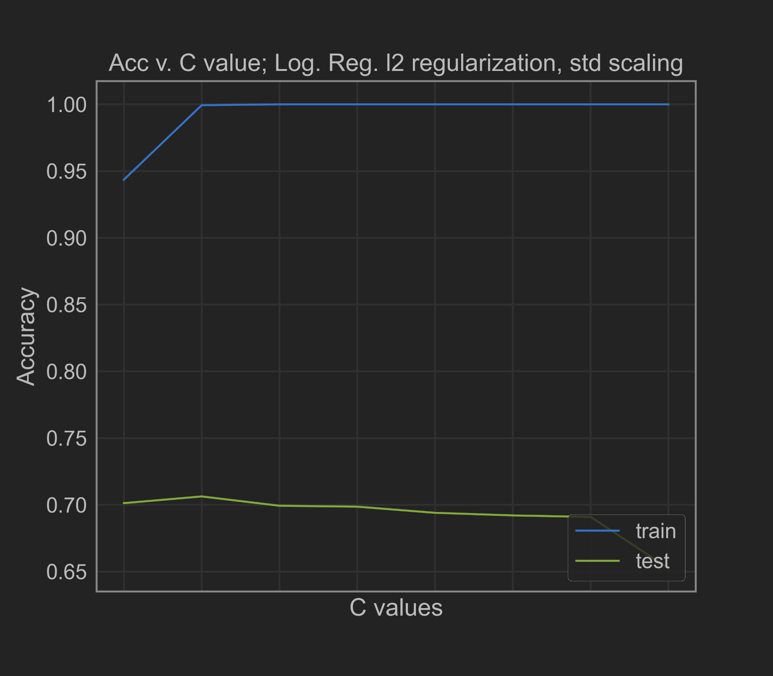
Logistic Regression; L2, std
C | Train | Test
0.001 | 94.3% | 70.1%
0.01 | 99.9% | 70.6%
0.1 | 100% | 69.9%
1 | 100% | 69.8%
10 | 100% | 69.4%
100 | 100% | 69.2%
1000 | 100% | 69.1%
1e7 | 100% | 65.2%

Slide 8
SVM
We varied:
Type of scaling
Type of kernel
Degree for the polynomial kernel
Amount of regularization

Slide 9
SVM; Linear
Best result
Standard scaler
C=0.01
80.7%

Slide 10
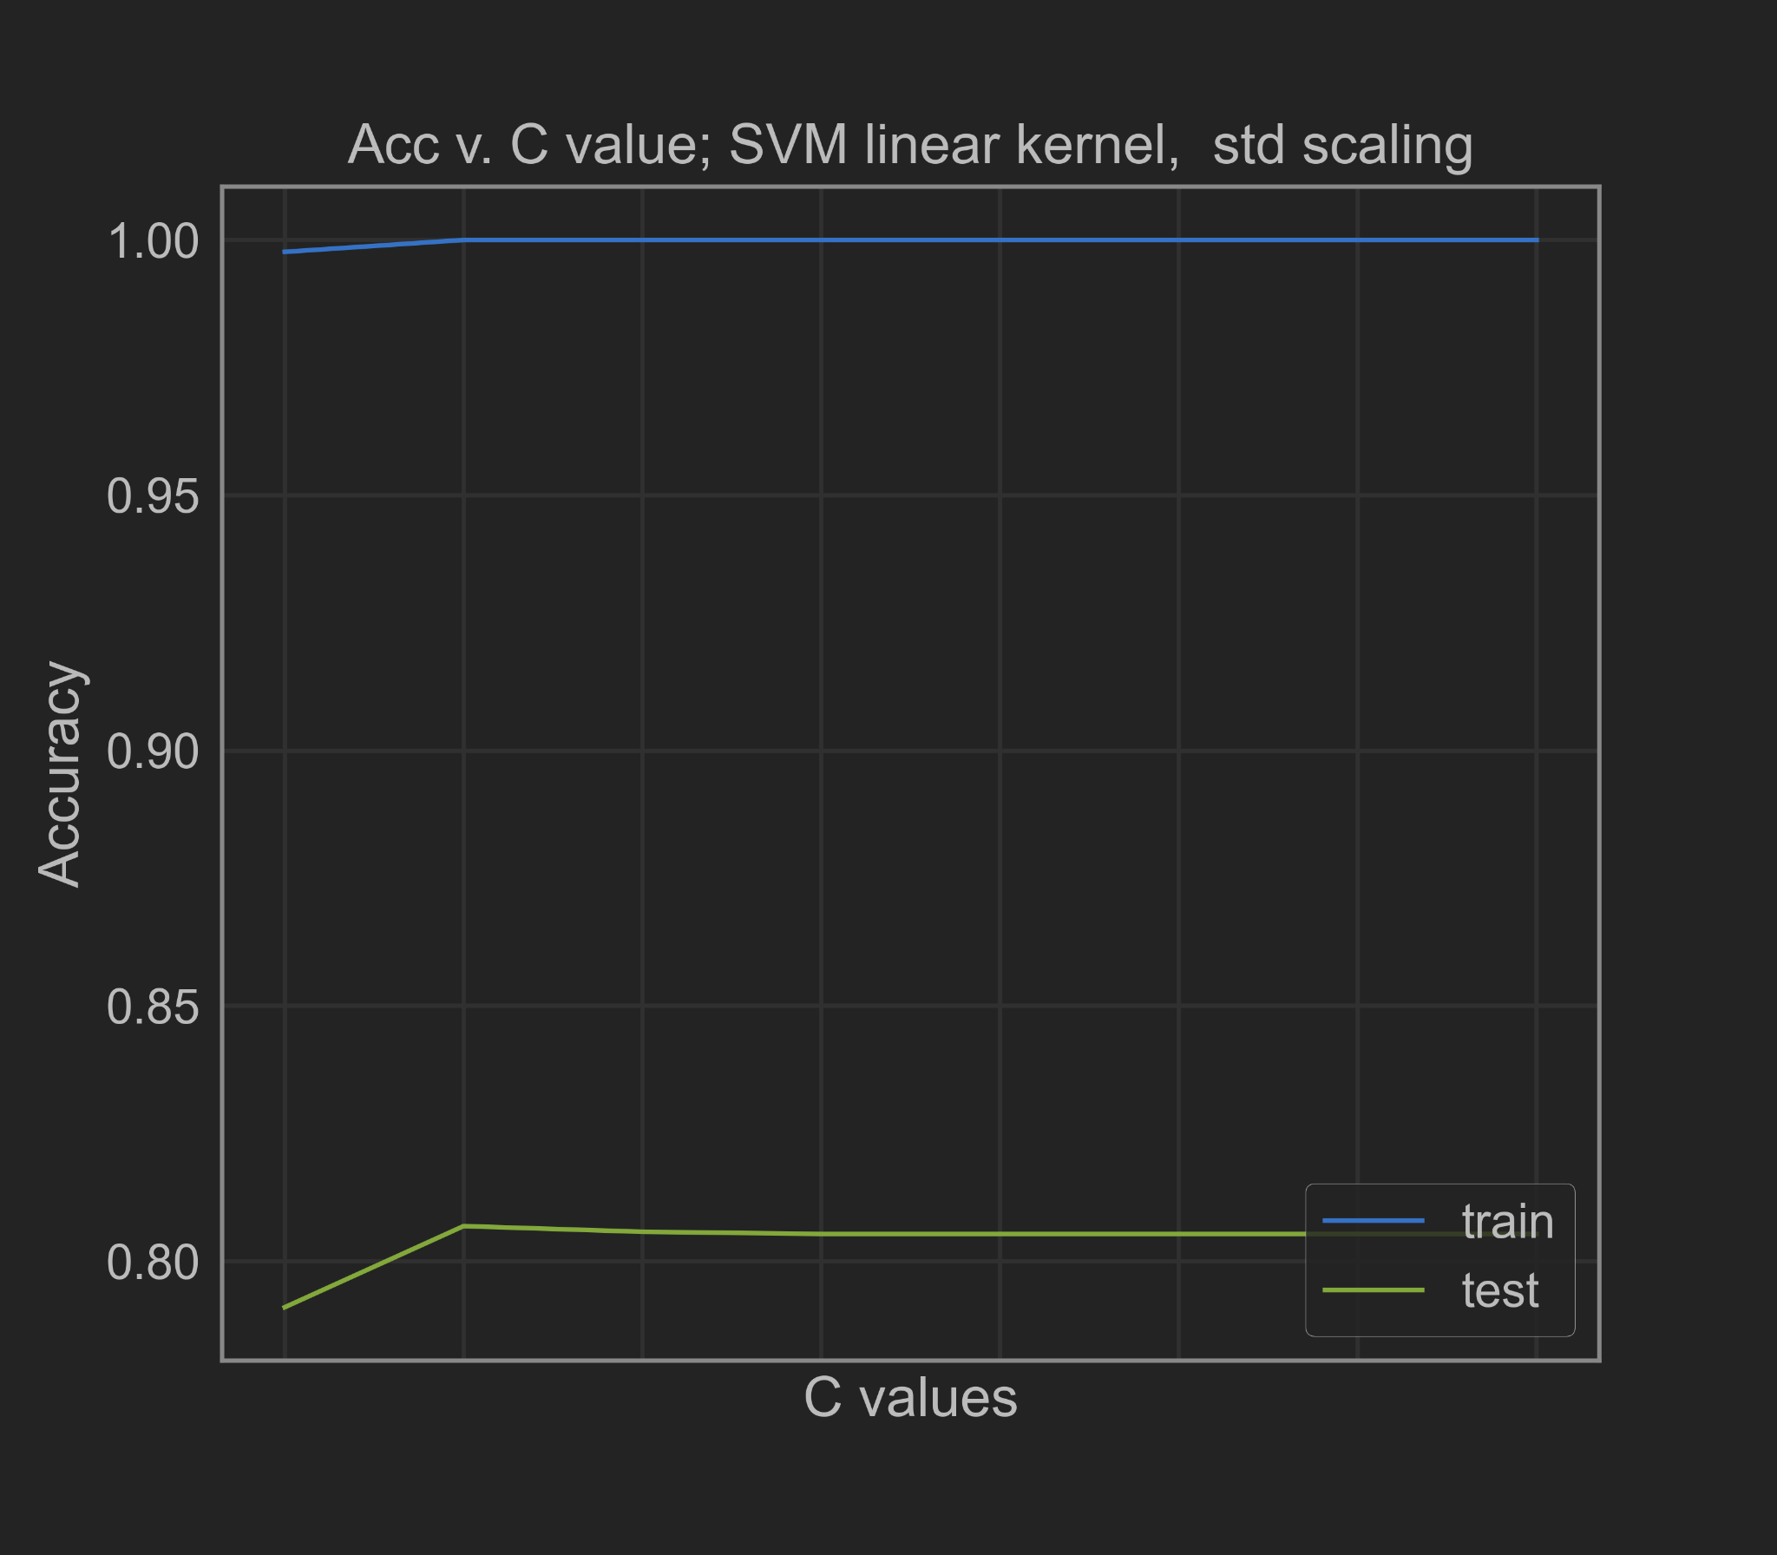
SVM; Linear, std
C | Train | Test
0.001 | 99.8% | 79.1%
0.01 | 100.0% | 80.7%
0.1 | 100.0% | 80.6%
1 | 100.0% | 80.5%
10 | 100.0% | 80.5%
100 | 100.0% | 80.5%
1000 | 100.0% | 80.5%
1e7 | 100.0% | 80.5%

Slide 11
SVM; RBF
Best result
Standard scaler
C=10.0
85.1%

Slide 12
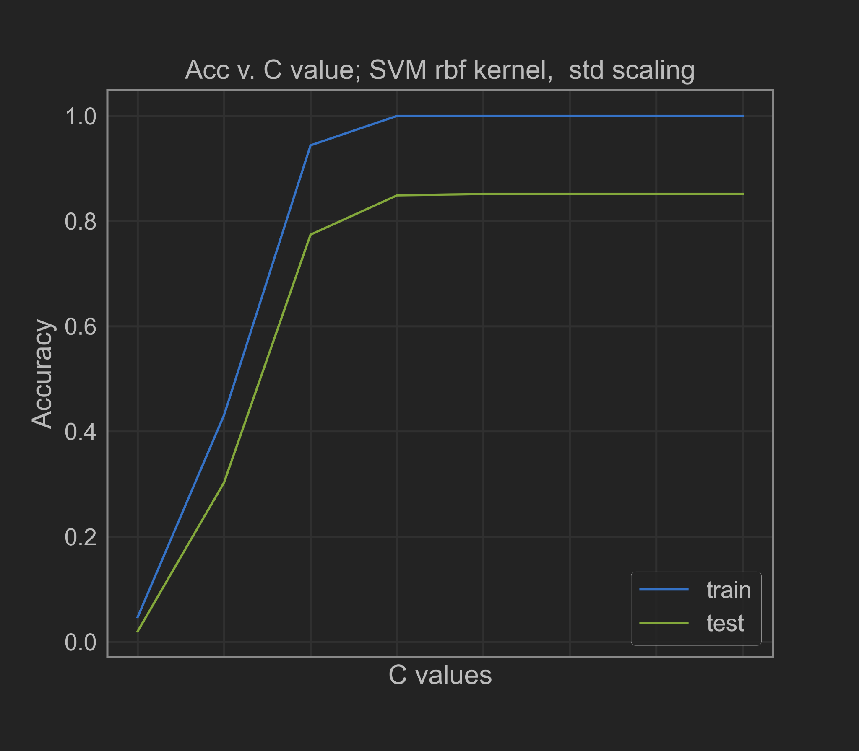
SVM; RBF, std
C | Train | Test
0.001 | 4.7% | 2.0%
0.01 | 43.1% | 30.3%
0.1 | 0.944054 | 77.42%
1 | 100% | 84.8%
10 | 100% | 85.1%
100 | 100% | 85.1%
1000 | 100% | 85.1%
10000000 | 100% | 85.1%

Slide 13
SVM; Polynomial
Best result
Standard scaler
C=100.0
Degree=2
85.5%

Slide 14
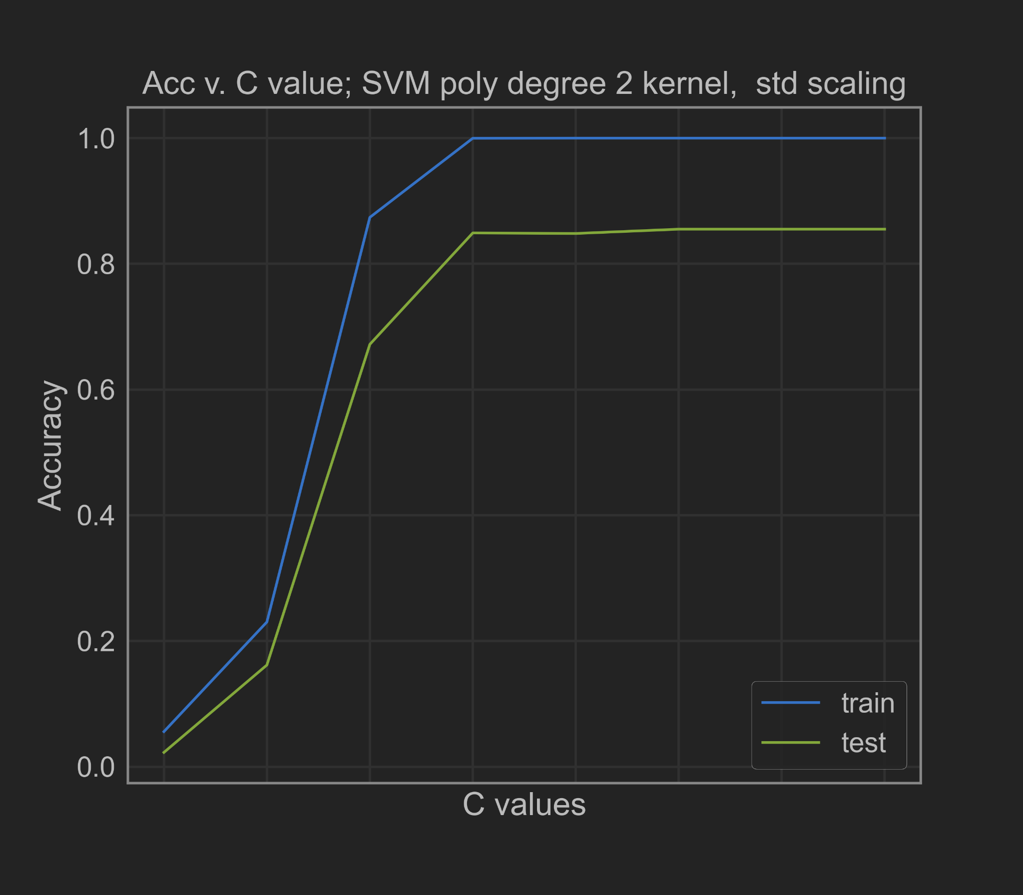
SVM; Polynomial degree 2, std
C | Train | Test
0.001 | 5.6% | 2.3%
0.01 | 0.230195 | 16.2%
0.1 | 0.873903 | 67.1%
1 | 0.999818 | 84.9%
10 | 100% | 84.8%
100 | 100% | 85.5%
1000 | 100% | 85.5%
10000000 | 100% | 85.5%

Slide 15
CNN Architecture
Conv2D
MaxPooling2D
Flatten
Dropout
Dense
x2

Slide 16

CNN Architecture
Conv2D
MaxPooling2D
Flatten
Dropout
Dense
Sets neurons to 0 with a specified probability
x2

Slide 17
Convolutional Neural Network
Early Stopping - halting training when validation error is going up
We varied:
Learning rate
Batch size
Lambda for l1 and l2 regularization
We held constant:
Learning rate = 0.002
Batch size = 256
Lambda for regularization = 0

Slide 18
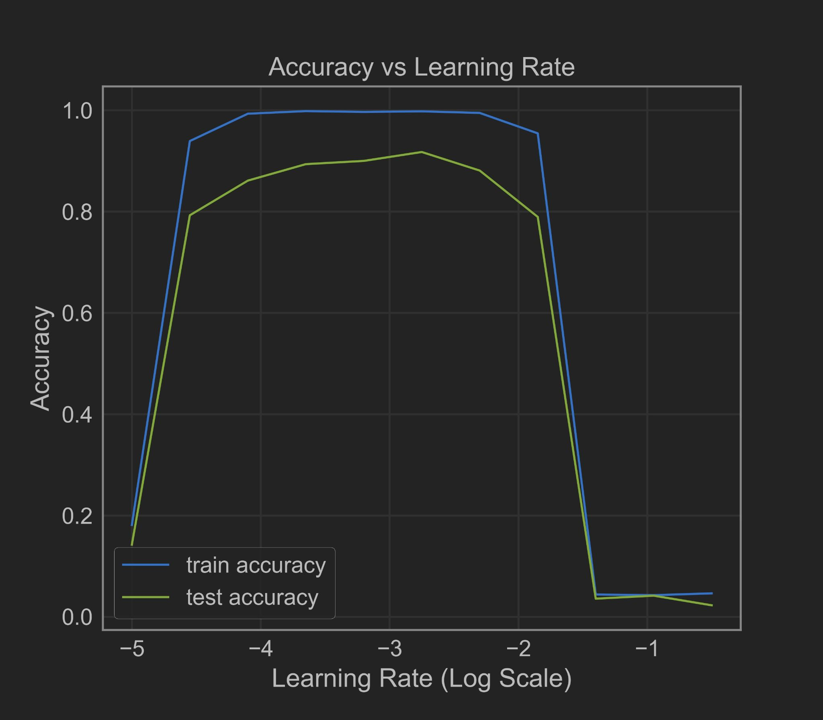
CNN - Test Accuracy vs Learning Rate
learning rate | train accuracy | test accuracy
-5 | 18.15% | 14.26%
-4.55 | 93.95% | 79.29%
-4.1 | 99.35% | 86.14%
-3.65 | 99.86% | 89.39%
-3.2 | 99.70% | 90.03%
-2.75 | 99.82% | 91.79%
-2.3 | 99.50% | 88.12%
-1.85 | 95.47% | 78.97%
-1.4 | 4.42% | 3.60%
-0.95 | 4.29% | 4.18%
-0.5 | 4.64% | 2.29%

Slide 19
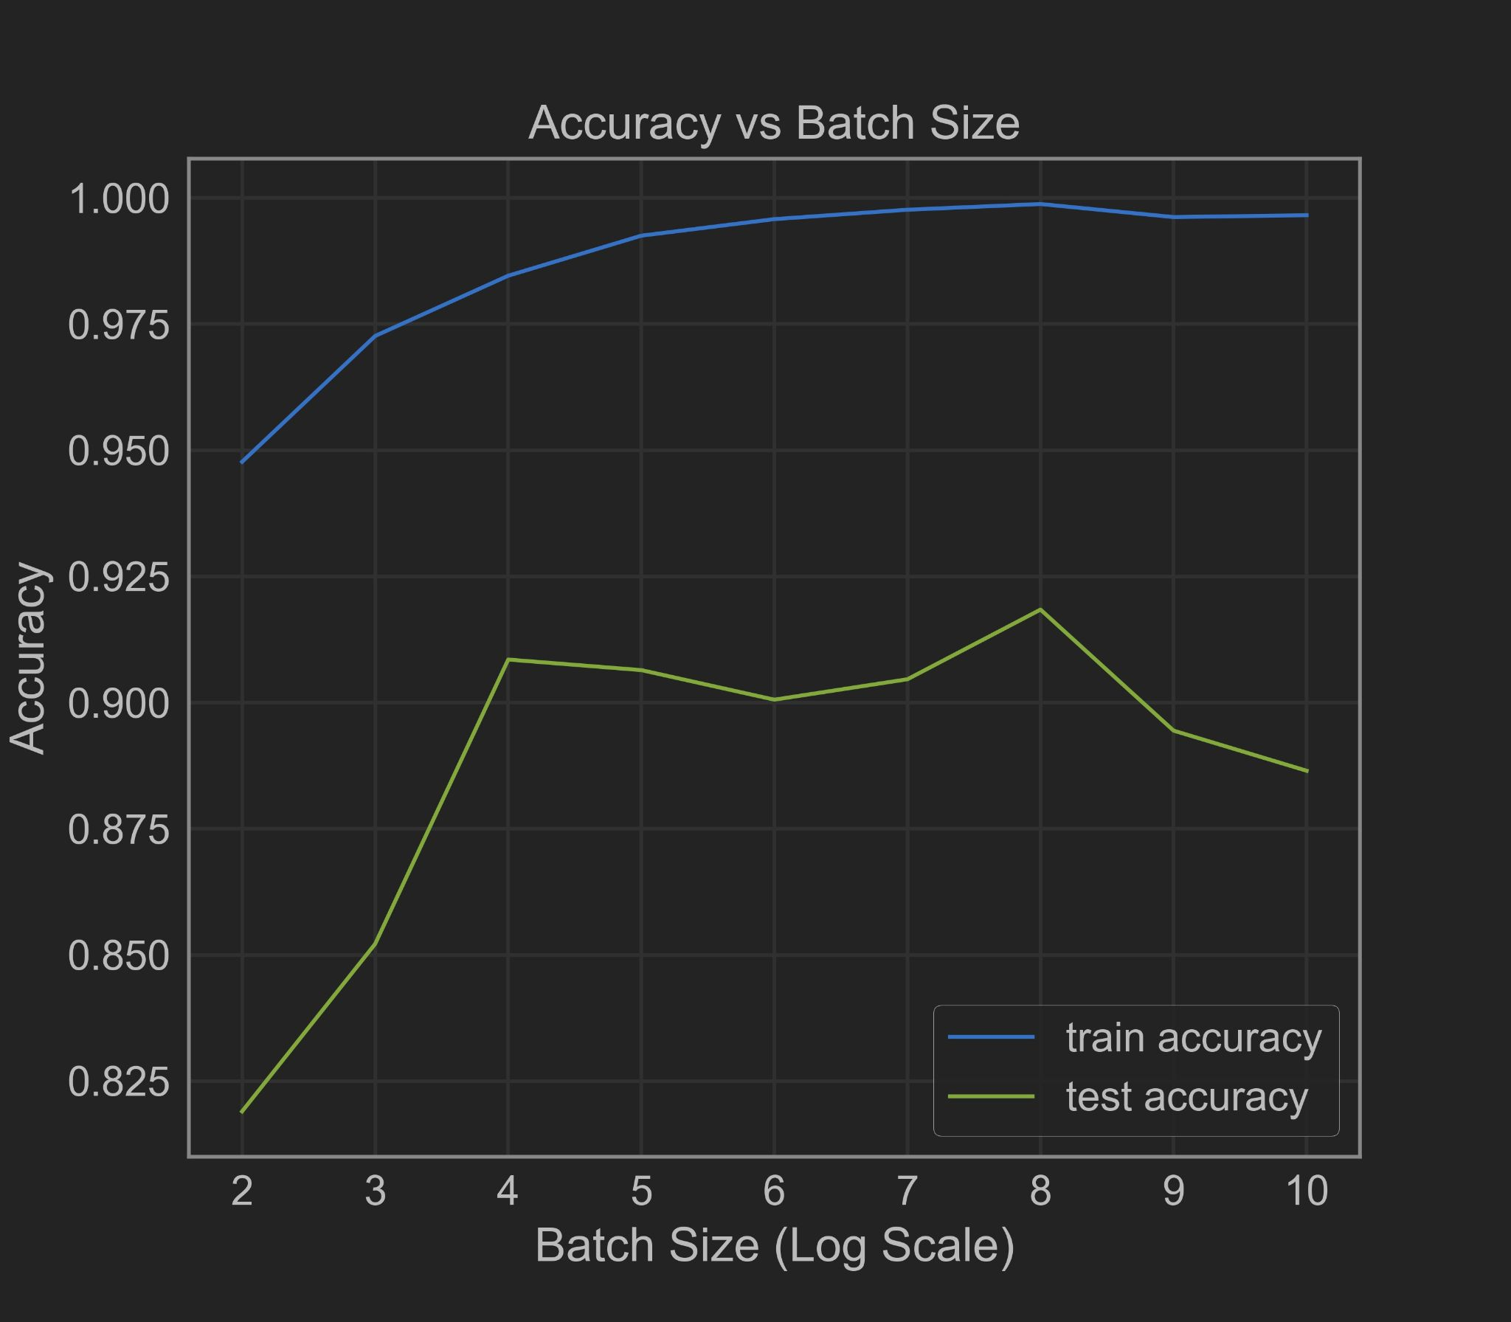
CNN - Test Accuracy vs Batch Size
batch size (log) | train accuracy | test accuracy
2 | 94.77% | 81.90%
3 | 97.26% | 85.22%
4 | 98.46% | 90.85%
5 | 99.25% | 90.64%
6 | 99.58% | 90.06%
7 | 99.77% | 90.46%
8 | 99.88% | 91.84%
9 | 99.62% | 89.45%
10 | 99.66% | 88.65%

Slide 20
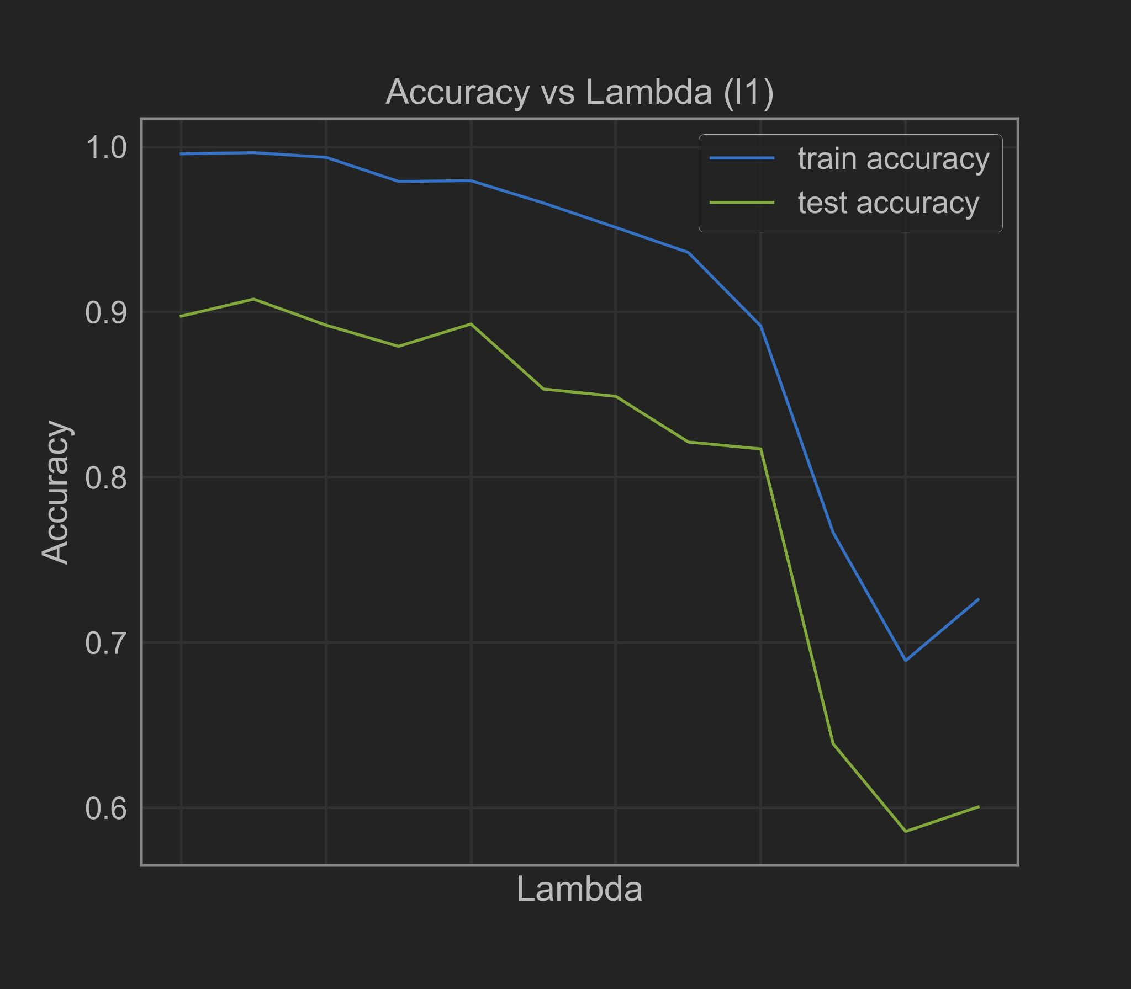
CNN - Test Accuracy vs Lambda (l1)
lambda (l1) | train accuracy | test accuracy
-inf | 99.58% | 89.75%
-3 | 99.65% | 90.78%
-2.75 | 99.36% | 89.21%
-2.5 | 97.91% | 87.93%
-2.25 | 97.95% | 89.28%
-2 | 96.60% | 85.35%
-1.75 | 95.12% | 84.90%
-1.5 | 93.61% | 82.14%
-1.25 | 89.16% | 81.72%
-1 | 76.65% | 63.87%
-0.75 | 68.91% | 58.58%
-0.5 | 72.60% | 60.05%

Slide 21
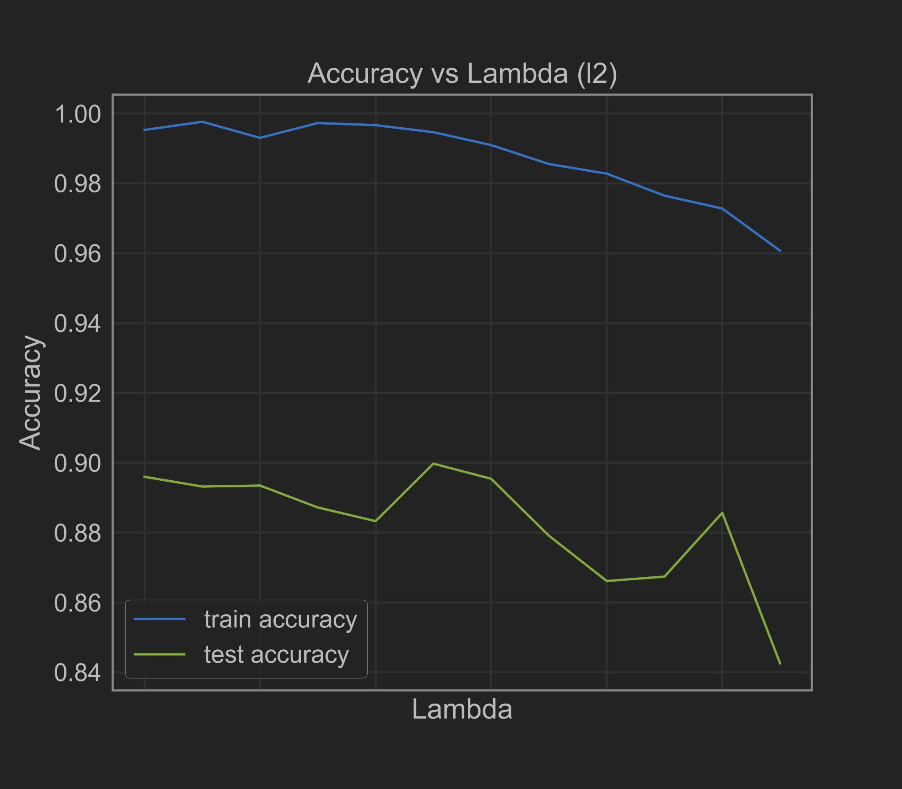
CNN - Test Accuracy vs Lambda (l2)
lambda (l2) | train accuracy | test accuracy
-inf | 99.53% | 89.60%
-3 | 99.77% | 89.32%
-2.75 | 99.30% | 89.35%
-2.5 | 99.73% | 88.72%
-2.25 | 99.67% | 88.33%
-2 | 99.47% | 89.97%
-1.75 | 99.10% | 89.54%
-1.5 | 98.56% | 87.91%
-1.25 | 98.28% | 86.61%
-1 | 97.65% | 86.74%
-0.75 | 97.28% | 88.57%
-0.5 | 96.07% | 84.26%

Slide 22
Overall Results
Model | Best Test Accuracy
LogReg | 70.64%
SVM (Linear) | 80.69%
SVM (RBF) | 85.17%
SVM (poly degree 2) | 85.51%
CNN (lr) | 91.79%
CNN (batch size) | 91.84%
CNN (l1 and l2) | 90.78%
CNN yielded the best results
>90% test accuracy
Regularization improved test accuracy

